Slide 1
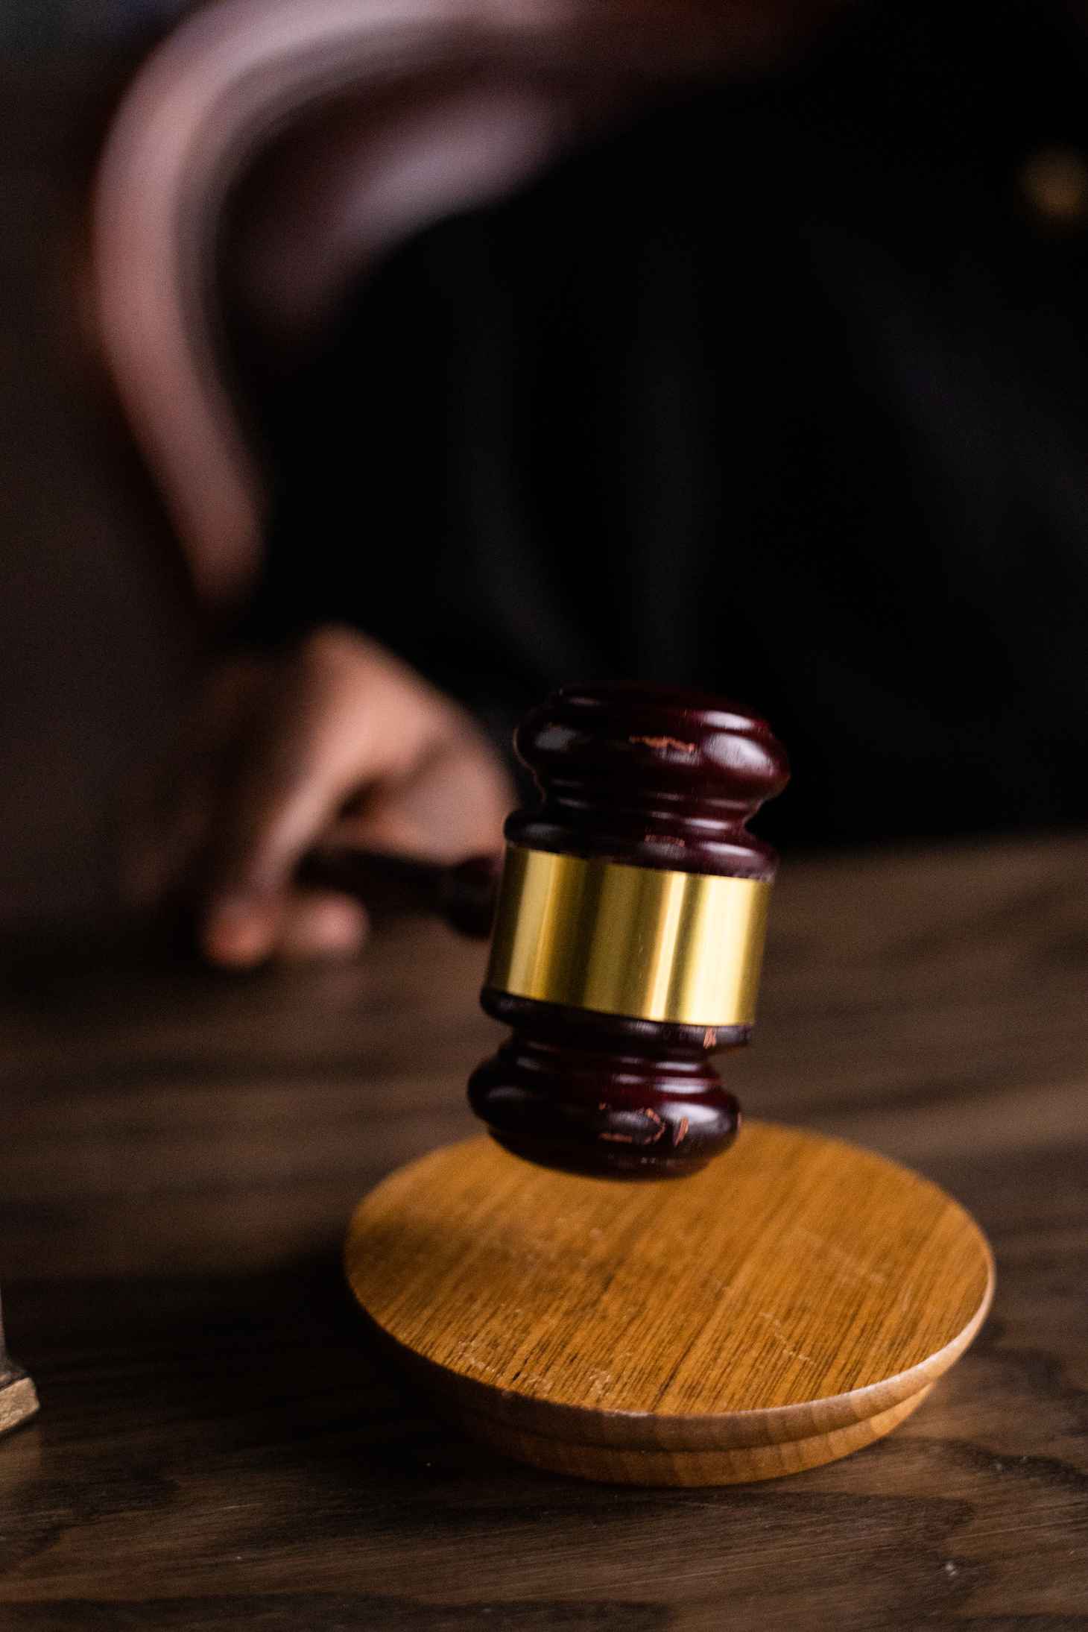


Administrative Tribunals
Master of Public Administration (MPA)
Department of Public Administration
TribhuvanUniversity

Slide 2

Introduction:
  ‘Tribunal’ is Latin term “Triburnus”
  An adjudicatory body which is constituted under any statute.
  It has the authority to settle certain types of dispute.

Slide 3

Continue…..
  Established by law and acts according to procedure prescribed by law.
  It performs judicial and quasi-judicial functions.
  A specialist court outside the judicial system.

Slide 4

Characteristics of the tribunals:
  Cheapness
  Accessibility
  Expertise
  Simpler
  Quicker
  More Flexible
  Informality

Slide 5

In the context of Nepal:
  Constitution of Nepal 2072- Article 126
  Three members (Triunion) – one chair person+2 members

Slide 6
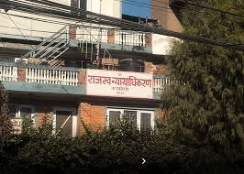
Administrative Tribunals of Nepal:
  Administrative Court
  Revenue Tribunal
  Foreign Employment Tribunal
  Debt Recovery Appellate Tribunal
  Information Technology Tribunal
  Labor Court
  Police Special Court
  Army Special Court
  Loan Recovery Tribunal

Slide 7
Administrative Tribunals VS Court:
Administrative Tribunal | Court (Judiciary)
Tribunals can be described as minor courts that adjudicate disputes in special cases. | It is a part of legal system which are established to give decisions on civil and criminal cases.
It is a Quasi-judicial body. | It is a judicial body.
Deals with special cases | Deals with variety of cases
Decisions are called Decree. | Decisions are called decree, judgments etc.
Dependent on the legislature | An independent Body
Not permanent in nature | Permanent in nature

Slide 8
"All courts are tribunals but all tribunals are not court"

Slide 9
Reasons for the growth of Administrative Tribunals:
  Overloaded courts
  Speedy disposal of disputes
  Policy consideration
  Inadequacy of judicial system
  Merits of system of Administrative Adjudication
  Need for expertise and technical knowledge
  Preventive measures;
  Local by nature

Slide 10
Disadvantages of Administrative Tribunals:
May violate the principles of rule of law and natural justice.
May upset the theory of separation of powers.
Staff may not have the background of law or training in judicial work.

Slide 11
References:
Administrative Law (Book)- Keshav Raj Pande
Administrative Law (Book)- Sambhu Prasad Khanal
https://www.youtube.com/watch?v=looUAsBJqVE
https://www.youtube.com/watch?v=EkjFQXxuIak
https://www.youtube.com/watch?v=ZyTTszjTN48
https://www.youtube.com/watch?v=yMeQMr2M4CY

Slide 12



THANK
YOU!
Any Questions?

