Slide 1
What is
Agenda Setting?

Slide 2
Policy Making Process:
Public policy is whatever governments choose to do or not to do - Thomas Dye
Policy making process encompasses the stages through which policies are developed, from identifying policy problems and setting agendas to implementing and assessing their impact.
It is how governments, institutions, and other actors identify, define, and respond to public policy problems

Slide 3

Stages of Policy Process:
Agenda setting
Policy formulation
Policy adaption
Policy implementation
Policy evaluation

Slide 4

What is Agenda?
A list of items that receives priority for actions.
Policy agenda is a list of subjects or problems to which people inside and outside government are paying serious attention at any given time. ( Kingdon 1984)
Items receiving active and serious consideration by important policy makers. (Edwards III & Sharkansky)

Slide 5
What is Agenda Setting?
It is a process by which problems and issues gain or receive attention from the public and policy makers.
The concept of Agenda Setting was developed by Walter Lipman in 1922 in his book 'Public Opinion'.
Dearing and Rogers (1996) considers the agenda setting process as an ongoing competition among issues proponents particularly to gain attention of media professionals, the public and policy elites.

Slide 6
Continue….
The process of transforming issues into government priorities in any public area (health, economy, education, agriculture, and social welfare etc.)
It is the process through which certain policy problems or issues gain prominence and enter the public and political discourse.
In the agenda setting elected and appointed officials place problems on the public agenda. Many problems are not acted on at all; while others are addressed only after long delays (Dunn 1996).

Slide 7

Characteristics of Agenda Setting?
It is most crucial phase of policy making.
It is concerned with the recognition of problems or issues for action.
It is a political process, conflictive and competitive.
It has ability to influence groups to action.
Preference of interest groups and decision makers.

Slide 8
Actors involved in Policy Agenda:
Organized Interests
Protest Groups
Party Leaders
Senior Officials
Advisors
Many individuals and Institutions
Civil society
International organizations: UNPD,UNO
Legislators
Academician's
Medias as well as public

Slide 9
Major Factors that Impact on Agenda Setting:
Group reactions to other group's action and success.
Leadership activity.
Crisis
Media coverage and activity
Protest movements
Presence of Elites
Political changes

Slide 10
Drawbacks of Agenda-Setting
Can lead to media bias and distortion of news: Media agencies often decide what news stories to report and how to report them to influence people.
It is the media centric theory. Here media dominates over its audience and works like a king and omnipotent

Slide 11
Classification of Policy Agenda:
Two basic types of agendas (According to Cobb & Elder (1972)
1. Systematic Agenda
2. Institutional agenda

Slide 12
1. Systematic Agenda:
Consists of all issues that are commonly perceived by the members of the policy community as meriting public attention and as involving matters within the legitimate jurisdiction of existing governmental authority.
It is a macro agenda (covers the widest range of potential issues).
2. Institutional agenda:
Institutional agenda is composed of those problems to which public officials or policy makers give serious and active attention.
It is an action agenda & will be more specific and concrete than a systemic agenda.
It is a micro agenda (covers those issues that are already considered by decision makers).

Slide 13
Agenda Items:
1. Old Items
Those that appear with some regularity on agendas. Eg:- Public employee pay increases, social security benefit increases, budget allocation.
2. New Items
New items are generated by particular situations or events. Such as a nationwide rail road strike, a foreign policy crisis.

Slide 14
Types of Agenda Setting:
Three types according to Rogers and Dearing (1988)
1. Public agenda setting - in which the public agenda is the dependent variable ( the traditional hypothesis)
2. Media agenda setting - in which the media agenda is treated as the dependent variable
3. Policy agenda setting - in which elite policy makers agenda are treated as the dependent variable. It is some times called political agenda setting.

Slide 15
Studying the Agenda Helps to:
Helps to understand social values at a given historical moment.
Allows to see the potential gaps between priorities of the government and society.
Reveals the priorities of different social groups.
Broadens our understanding of policy alternatives, decisions, and choices.

Slide 16
Models of Agenda Setting:
1. John Kingdon’s Agenda Setting Model
2. The Iron Triangle Model

Slide 17
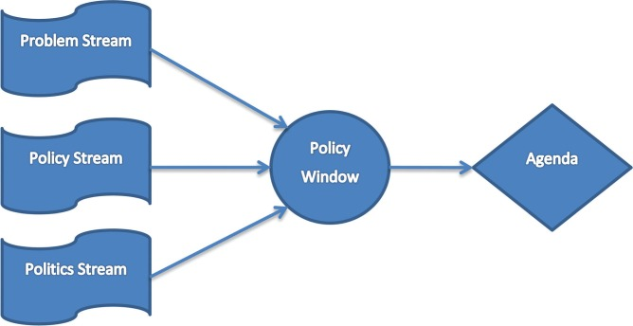
1) John Kingdon’s Agenda Setting Model

Slide 18
2. The Iron Triangle Model
congressional Agencies/ Legislature
Interest Groups
Executive Agencies

Slide 19
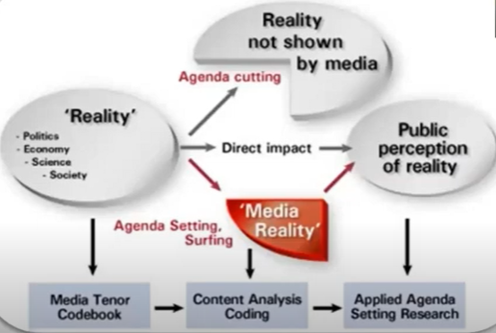
Media’s role in Agenda setting
Media coverage can lead to increased public concern.
John Kingdon found that the media didn't drive the agenda in some fields.
The media has considerable power to set the agenda after focusing events.

Slide 20
What do you think is on the agenda now?
(What are they talking..)
In the House of Representatives, or Pratinidhi Sabha is one of the houses of the Federal Parliament of Nepal, with the other house being the National Assembly.
In the national media (The Kathmandu post, The Himalayan Times, Annapurna Post, Nepali Times, Gorkhapatra, Kantipur, The Rising Nepal etc)
In your state government
In your local government
In the local news media

Slide 21
References:
Aspects of Public Policy – By Pro. Dr. Rajib Bickram Rana (Central Department of Public Administration)
Public Policy-Making –By James E. Anderson
Studying Public Policy (Policy cycles and policy subsystems). – By Michael Howlett & M. Ramesh
https://www.scielo.br/j/rap/a/jfNJNmk4Cf7dnybYgTn7HYL/#:~:text=Agenda%20setting%20is%20one%20of,(2003).
https://en.wikipedia.org/wiki/Agenda-setting_theory#:~:text=The%20agenda%2Dsetting%20by%20media,it%20receives%20(issue%20saliency).
https://macsphere.mcmaster.ca/bitstream/11375/14922/1/fulltext.pdf

Slide 22

Thanks!
Any questions?

