Slide 1


Rationalism

Slide 2
Table of Contents:
Introduction
Rationalism
Examples
Modern rationalists
Other contributors to Rationalism
Features of Rationalism
Constraints of Rationalism
Importance of Rationalism (in the context of Nepal)
References

Slide 3
Introduction:
Philosophy is a field that involves critical thinking.
Public policy is a collection of laws and regulations that maintain order or solve a social problem.
The word “Rationalism” derives from the Latin word “Ratio” meaning “Reason”.

Slide 4
Rationalism:
Rationalism is the epistemological theory (The theory of knowledge).
The term ‘rationalist’ was first used in 1620s.
Rationalist administrator is the management scientist.
The principle of basing reason and knowledge-based ideas and actions rather than emotional response or religious faith.
It is the most optimistic policy philosophy.

Slide 5
Continue:
Rationalism accept reason as the supreme authority than opinion or belief.
It believes that the worlds' difficulties can be managed by employing reason and developing analytical tools.
It believes in scientific analysis, logic, and systematic inquiry.
Rationalism encourages government by design-planning, social engineering, and intervention.

Slide 6
Continue:
Real knowledge can never be attained through sense experience.
True knowledge originate from reason.
Three basic claims in rationalism: Intuition/Deduction, The innate ideas, A priori reason.
The "scientific method" is one of rationalism's great gifts to mankind (if something cannot be proven through a repeatable experiment, we do not consider it to be true).

Slide 7
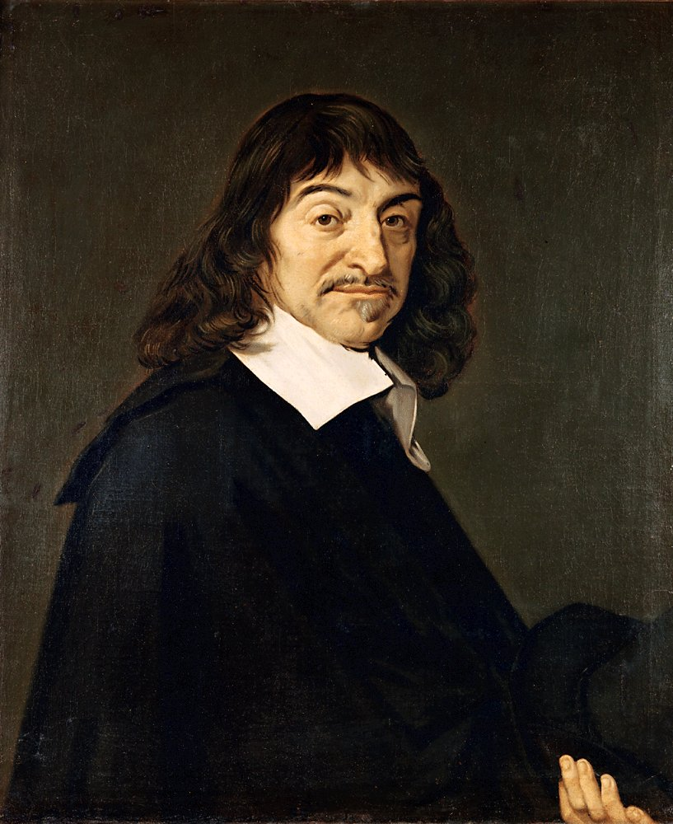
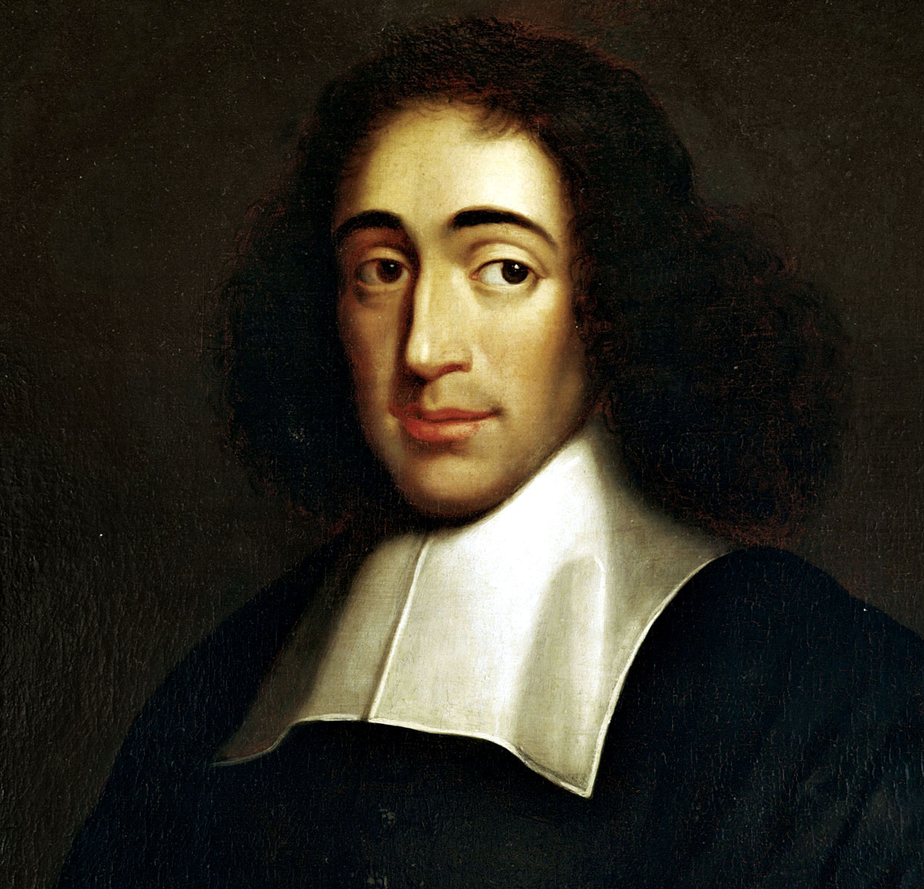
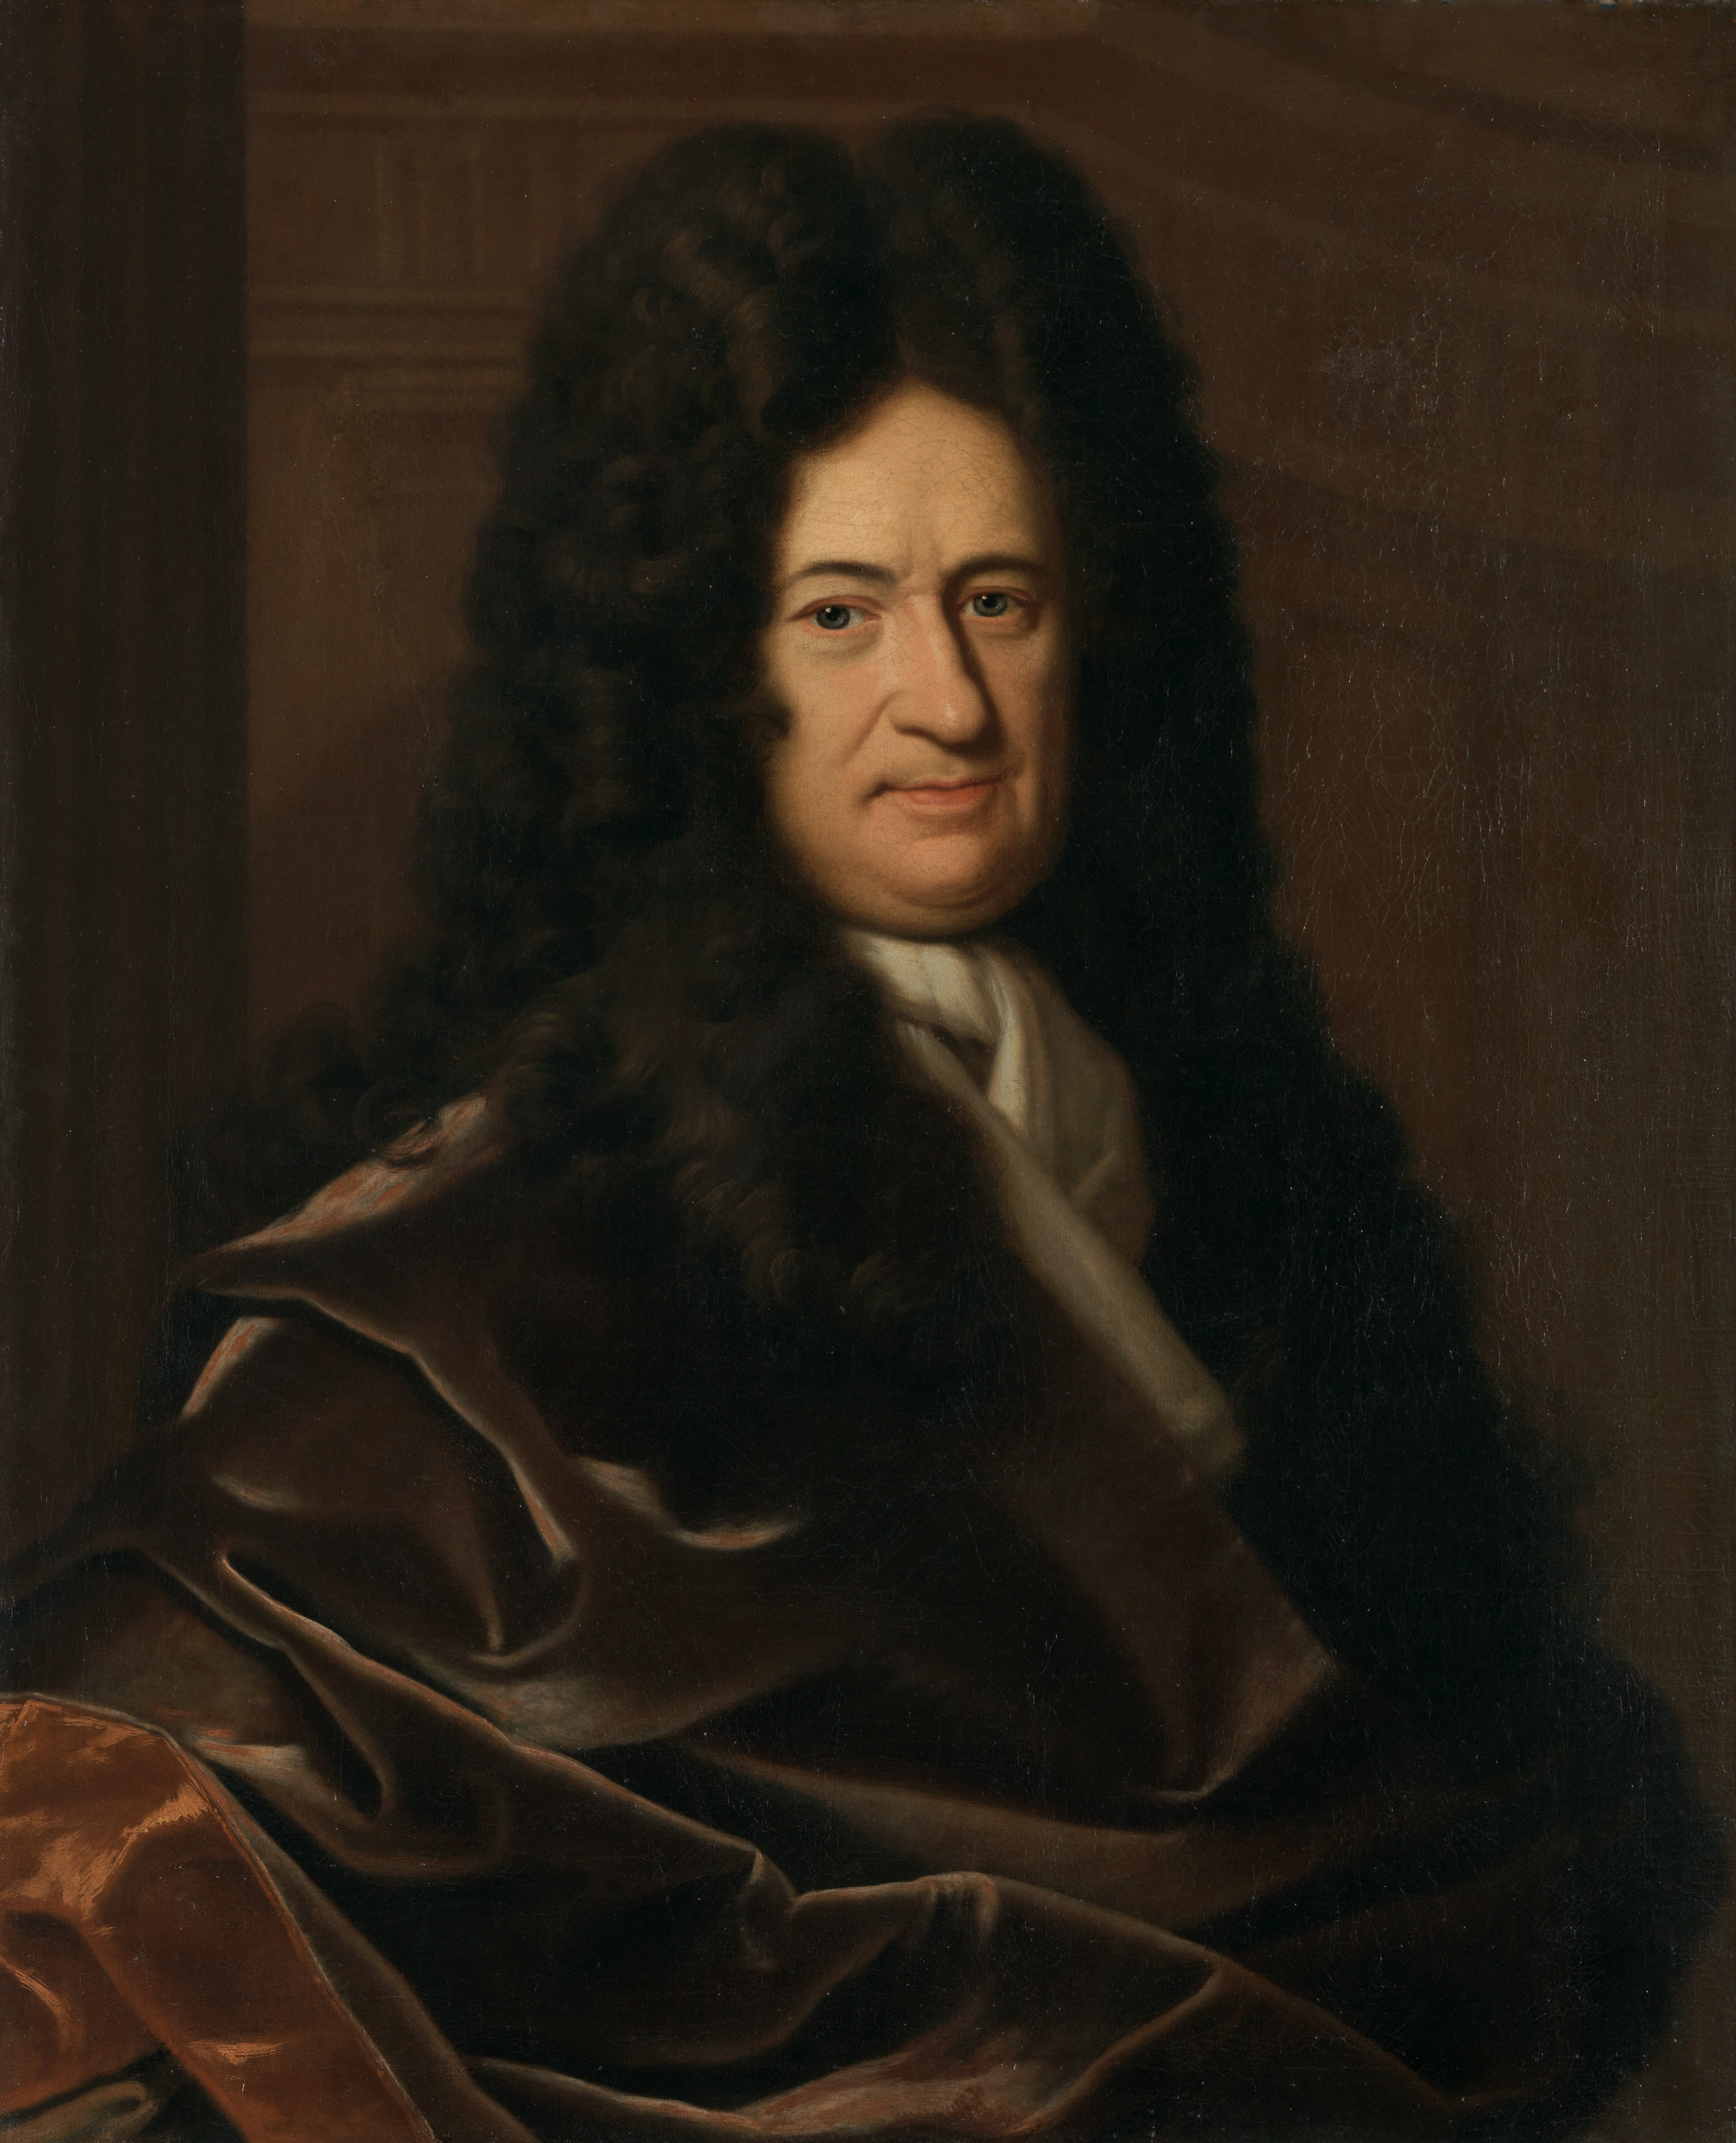
Modern Rationalists:
Rene Descartes
Baruch Spinoza
Gottfried Wilhelm Leibniz

Slide 8
Rene Descartes
Father of modern rationalism
Method of Doubt
“I think, therefore I am”
The information gathered through the senses are not accurate.
Eternal truths can only be discovered and tested through reason.

Slide 9
- Gottfried Wilhelm Leibniz
‘
Everything that exists and everything that occurs have a reason to be or to happen, and that this reason can be known and understood. This is known as the principle of sufficient reason.

Slide 10
Other Contributors to Rationalism:
Bacon
Plato
Aristotle - Politic
Max Weber (Bureaucratic Theory)
Taylor (Scientific Management Theory)- Brought science to administration.

Slide 11
Features of Rationalism:
Reason-based
Reformative & Practical
Expert-driven
Prioritize reason over emotion.
Rejects all knowledge derived from sense experience.
It consider mathematics the perfect science, because all its postulates are purely rational.

Slide 12
Constraints of Rationalism:
It is a narrow perspective.
It ignores intuition, emotion, and understanding.
Pure reason and logic-based policy decisions can fail to address the diverse needs and desires of the citizen.
It limits the formulation of efficient and inclusive policies.
Difficulty in exercise.

Slide 13
Continue:
Maximizes or focus on rewards such as power, status, money, and re-election.
It is expected to produce optimal results, but in reality it doesn’t always do so.
There is conflict between rational choice and need for actors.
Dilemma of political feasibility.
Problem of cost benefit analysis (constraints on collecting information).

Slide 14
Importance of Rationalism (in the context of Nepal):
Reason based decision making.
Policy making in parliament.
Evidential and fact based logical analysis.
Formulate and implement public policy.
Scientific outlook on data & information.
Making choices carefully weighing available information to give rational outcome.
Choosing the best option with the best solution.
Identification & ranking of a goals.

Slide 15
References:
https://nanopdf.com/download/bozemanchap3-michigan-state-university_pdf
https://myrepublica.nagariknetwork.com/news/progressivism-approaching-rationalism-over-radicalism/
https://myrepublica.nagariknetwork.com/news/shattering-the-shackles-of-untrammeled-rationalism/
https://www.vocabulary.com/dictionary/rationalism
https://englopedia.com/rationalism-with-characteristics-and-representatives-detail/
https://youtu.be/7KPcvaPIt3s?si=FOA_8iuv7R9O9TcA
https://youtu.be/VtWs1jLw4Y4?si=e1sEJwqsXFBHfV4T
https://www.scribd.com/document/496481733/Unit-2#:~:text=%EF%81%B6%20Six%20policy%20philosophies%20will,pragmatism%2C%20transferalism%2C%20and%20egoism.&text=protectorism%20is%20that%20policy%20exists,emerges%20early%20in%20political%20philosophy.

Slide 16

Thanks!
Any questions?

