Slide 1
Resource Bases &
Resource Mobilization

Slide 2
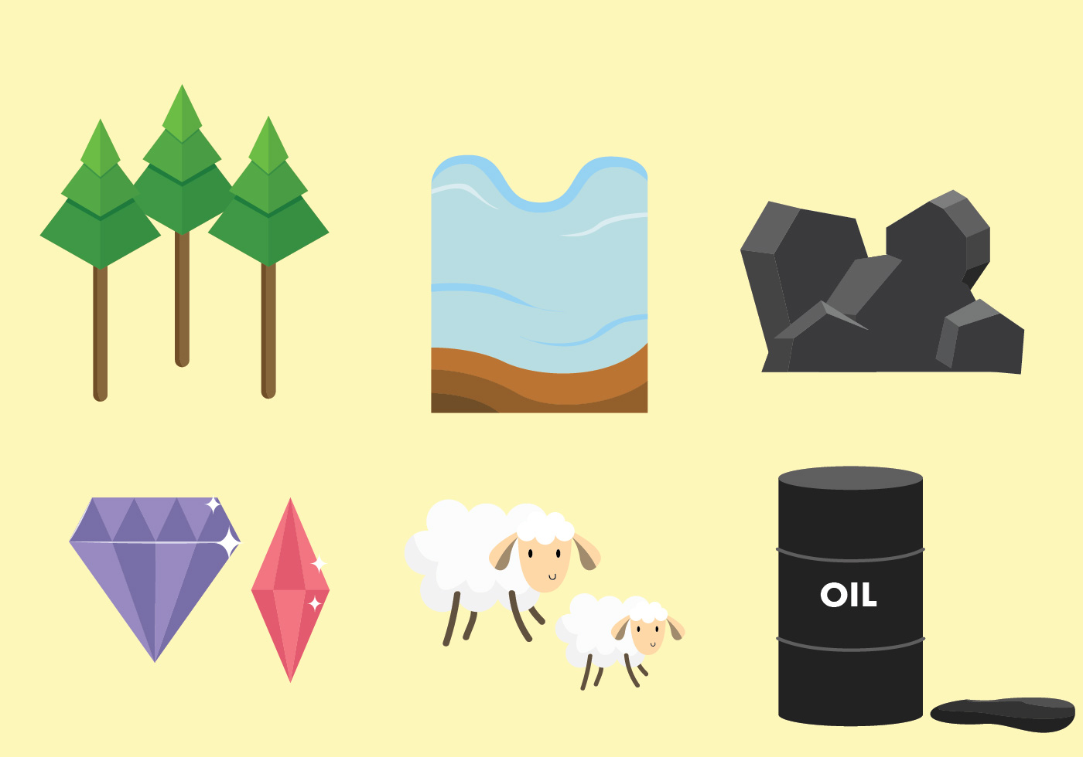

Resources:
A resource is something that can be used for making profits or benefits. i.e. Financial resources, Human resource, Natural resources.
Or Elements necessary for the running of an organization.
Resource providers: NGO, INGO, Businessmen/Private sectors, Institutions, Individual, etc.

Slide 3
Class of Resources:
Physical goods
Office equipment
Training materials
Vehicles & Furniture
Human Resources
Regular volunteers
Free consultancy
Consultants
Advisors
Financial Resources
Grants
Money of the project
Membership
Technical Cooperation
Trainings
Support from experts
Scholarship
Contributions to the programs

Slide 4

Resource mobilization
Resource mobilization means getting the right type of resources at the right time and in right price and using these resources in right way.
It prefers team effort and commitment.
It involves obtaining various resources from a multitude of partners, by different method.

Slide 5
Features of Resource Mobilization
Resource identification
Identification of Resource Provider
Identification of mechanism to receive resource
Right use of resource
Knowledge and skills to Resource Mobilization
Human skills, service, information, equipment
Seeking out new resource
Thought of institutional sustainability
Lower financial risk

Slide 6
Outline of Resource Mobilization:
Mechanisms
Various ways to receive means/resources
Resource Mobilization
Resources
Various types of goods which are essential.
Resource Provider
individual/organizations that provide resources.

Slide 7
Importance of Resources Mobilization
To diversify and expand resources.
To formulate an independent budget.
To decrease dependency on others (loan/fund providing agencies).
To establish Better relations with the stakeholders i.e. customers, vendors & employees.
To provide continuity and stability to the organization and its work.
For sustainability of the Organization and program.
For maximum use of domestic capital and skills.

Slide 8
Major Issues in Mobilization of Resources:
Poverty (create a dependency on foreign country for financial resources).
Foreign aid comes with its fair share of restrictions and conditions.
Limited domestic public resources

Slide 9
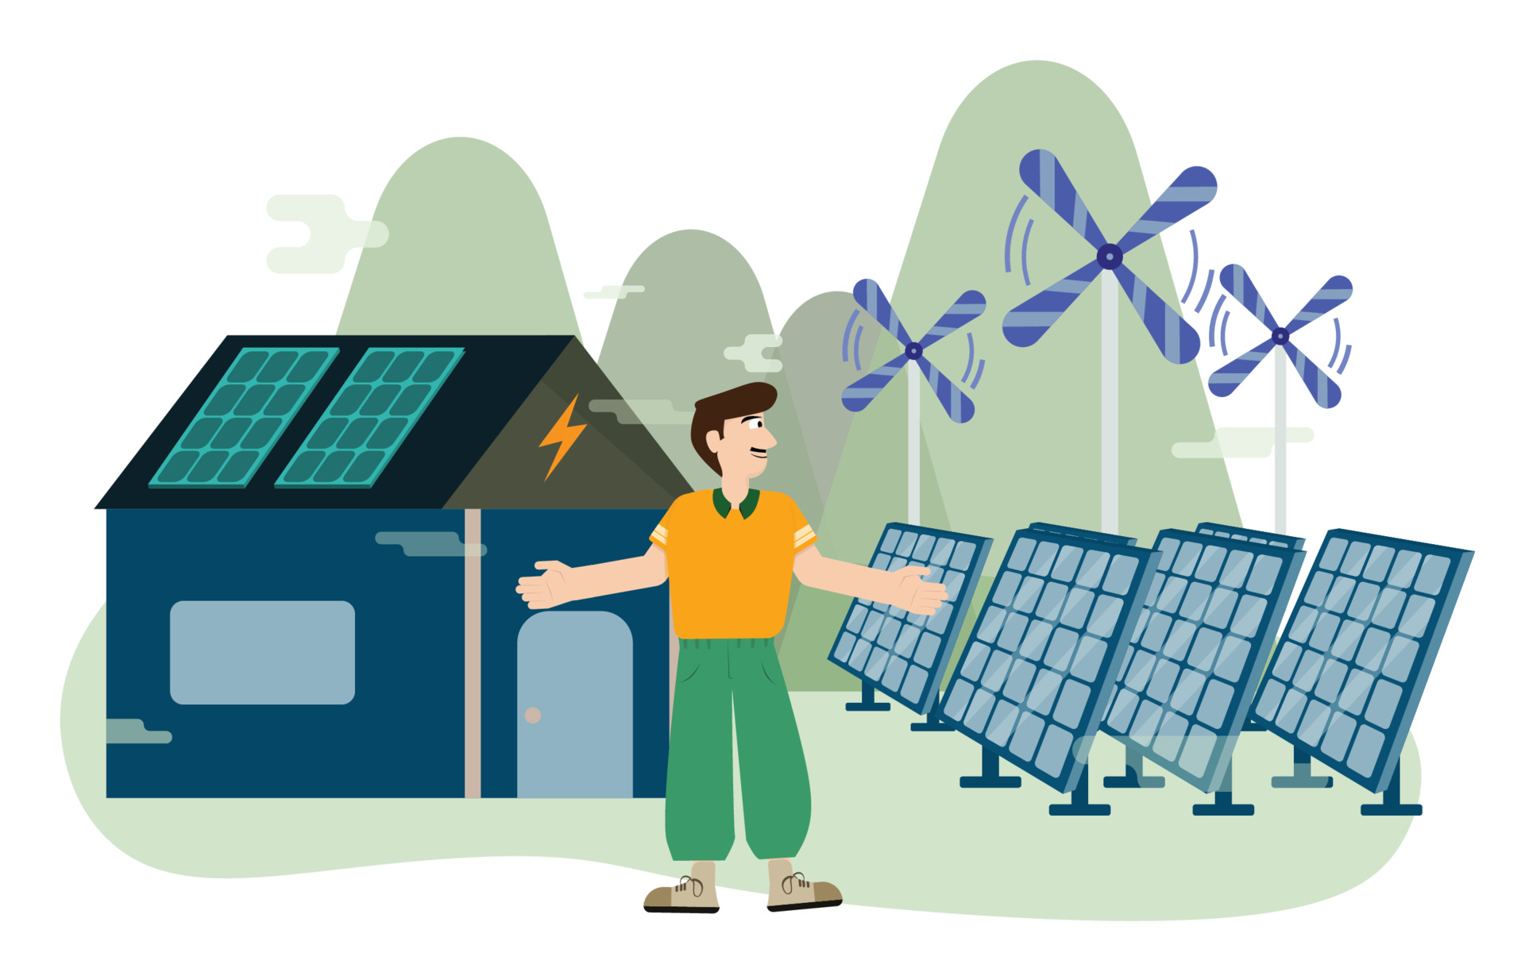
Conclusion
Resource mobilization is the process of getting resources from resource provider, using different mechanism, to implement the organization's work for achieving the pre-determined organization goals.
All the types of resources should be mobilized properly to achieve the organization’s goal.

Slide 10
References
https://www.ain.org.np/partnership_docs/Module%20on%20Resource%20Mobilization-English.pdf
https://www.youtube.com/watch?v=MYlWNKpVLZs
https://www.youtube.com/watch?v=D4XtytG9CqA
https://en.wikipedia.org/wiki/Resource_mobilization
https://www.insightsonindia.com/indian-economy-3/resource-mobilization/issues-faced-in-resource-mobilization-in-recent-times/

Slide 11




