Slide 1
Significance of HRM in 21st Century in a Context of Developing Countries like Nepal

Slide 2
Contents
Introduction of HRM
Evolution of HRM
Functions of HRM
Importance of HRM
Factors Influencing HRM
Why Nepal is a Developing Country?
HRM in Nepal
HRM Programs in Public and Private Sector
Case Studies
HRM Policies in Nepal
Problems in HRM (in context of Nepal)
Challenges of HRM
Conclusion
Recommendations
References

Slide 3
Human Resource Management (HRM)
HRM is the study of activities regarding people working in an organization. It is a managerial function that tries to match an organization’s needs to the skills and abilities of its employees.
Human resources management (HRM) is a management function concerned with hiring, motivating and maintaining people in an organization. It focuses on people in organizations. Human resource management is designing management systems to ensure that human talent is used effectively and efficiently to accomplish organizational goals.

Slide 4

HRM is a process consisting of the acquisition, development, motivation & maintenance of human resources.
- Stephen P Robbins

Slide 5
Robbins 4 Functions
Procurement - Includes planning, recruitment, selection, placement and orientation of employees.
Development - It is the training and educating of the workforce.
Motivation - It is concerned with factors that stimulate a workers effort and performance.
Maintenance - It includes provision of benefit services and working condition that maintain employees commitment.

Slide 6
Human resource management (HRM) in 21st century is a process that utilizes the skills and knowledge of employees in order to achieve organizational goals.
- Monody & Noe (2005)

Slide 7
Evolution of Human Resource Management
Personnel
( In 70s century)
Personnel Management
( 1945-1979)
Human Resource Management
( 1990)

Slide 8
Evolution of HRM
Industrial Revolution Era (19th century)
Trade Union Movement Era (close to the 19th century)
Social Responsibility Era (beginning of the 19th century)
Scientific Management Era (1900-1920s)
Human Relations Era (1930s-1950s)
Behavioral Science Era (1950s-1960s)
Systems and Contingency Approach Era (1960 onwards)
Human Resource Management Era (1980 onwards)

Slide 9
Effective HRM Implementation
Provide Benefits to Employees
High Employee Satisfaction
Highly Engaged in their Work
Success of Organization
Increase Work Productivity

Slide 10
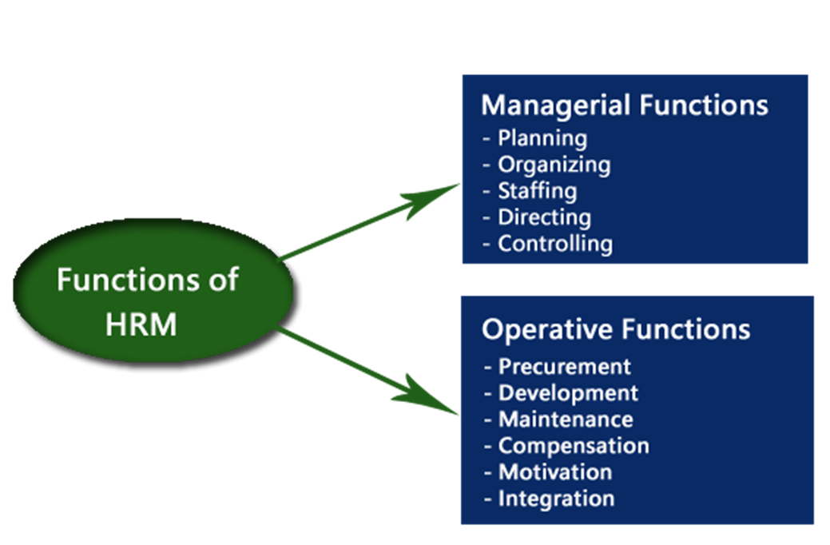
Functions of Human Resource Management

Slide 11
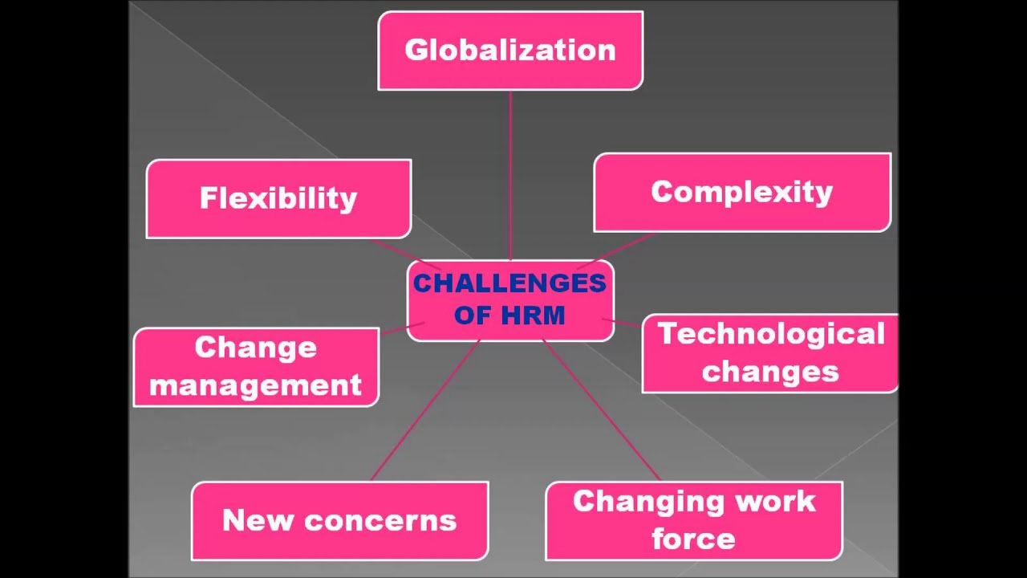
Challenges of Human Resource Management

Slide 12


Slide 13
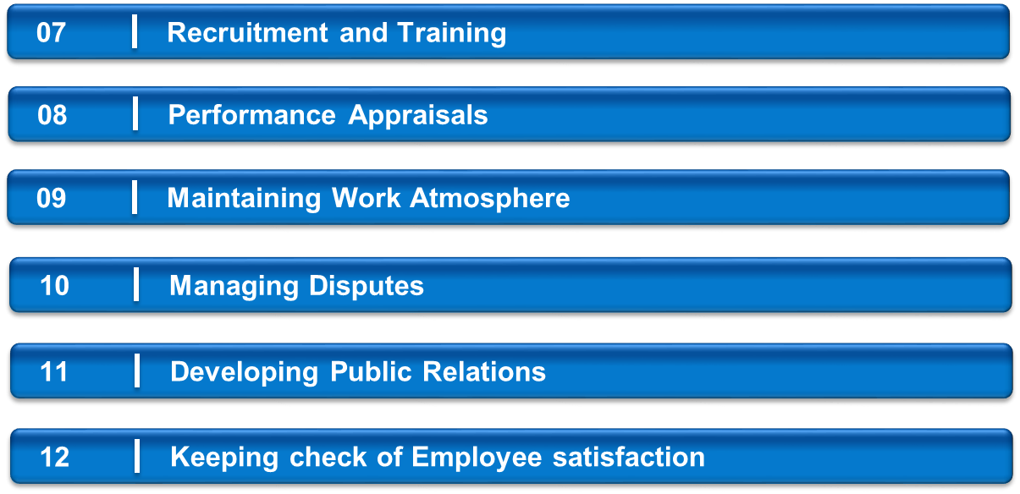
Continue….
02
0
04
05
Smoother Communication
06

Slide 14
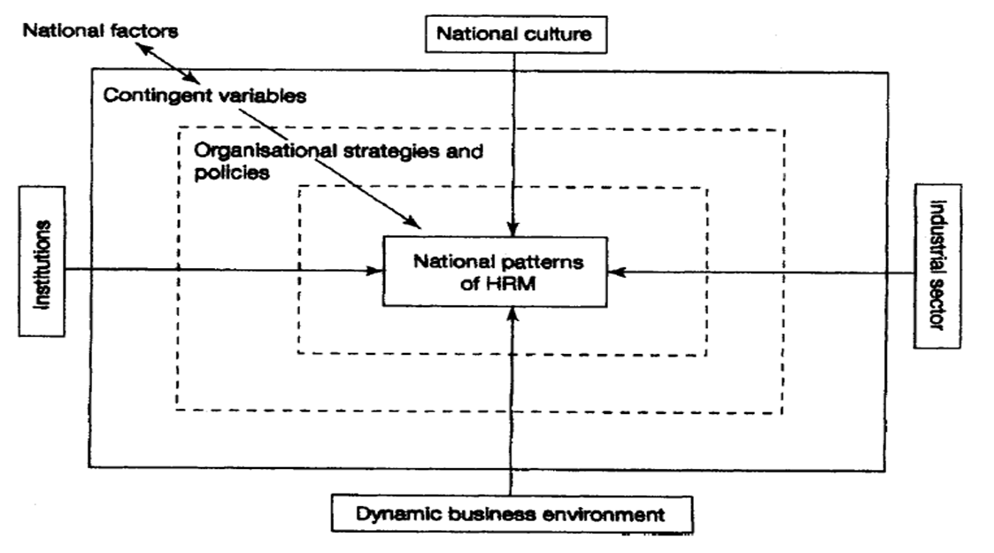
Factors Influencing Human Resource Management
Budhwar and his associates proposed factors that influence HRM polices and practices
1. National factors:
national culture, national institutions,
business sectors and dynamic business environment
2. Contingent variables:
age, size, nature, ownership, life cycle stage of organization,
trade unions, interests of stakeholders
3. Organizational strategies:
polices related to HR functions & labor markets
HRM is in early stage in developing countries
National factors play major role in HRM policy practice
in developing countries

Slide 15
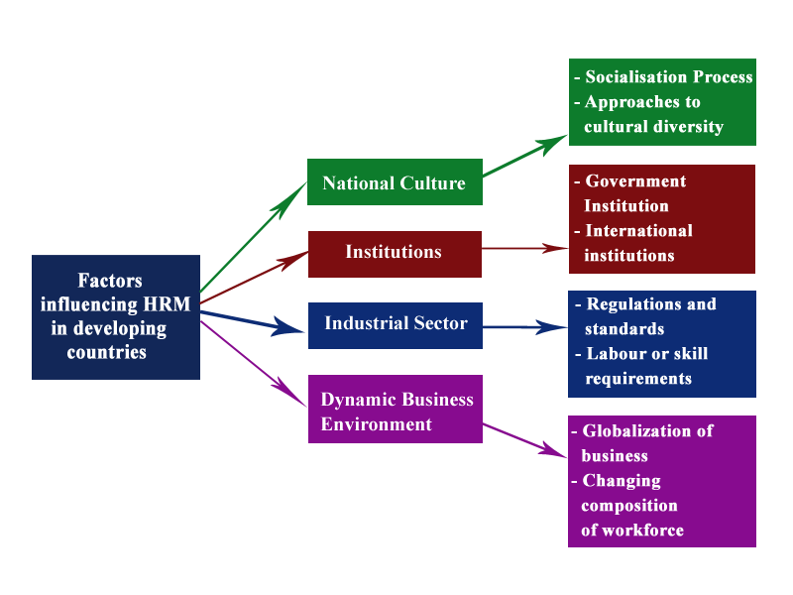
Details of sub-components of national factors determining HRM.

Slide 16
Nepal is a developing country. Why?
Poverty
Political Instability
Low per capita income
Instability of agricultural products
Meagre exports (Instability of exports of goods and services)
Victims of disasters

Slide 17
Human Resource Management in Nepal
Still in the phase of evolving through personnel department to HR department in many organizations.
Growing from traditional record keeping/ administrative work to strategic planning, research and development.
Government Owned Organization
Education & Training
Job rotation
Promotion
Private Organization
Performance goal (Role clarity)
Performance review
Education and Training
Promotion

Slide 18
HRM Programs in Government Owned Organization
Education and Training
  No training need assessment – Less risk in evaluation
  Job Nature - Permanent Job
Job Rotation
  Routine - Changeable
Promotion
  Seniority counts – Ranked based promotion
  Work performance is underestimated – Less evaluation for Work performance

Slide 19
HRM Program in Private Sector
Performance Goal ( Role Clarity )
  Challenging and visible assignments
  Mutually set ( between staff & organization )
  Clear Deadlines
Performance Review
  Reviewing staff performance against performance goals
  Feedback to staff on their performance
Education and Training
  Job related training
  Career focused education and training

Slide 20
Continue…..
Succession Planning
  Empowers staff to take higher responsibilities in the future
  Motivates staff to step up advancing their internal career
Promotion
  Encourages good performers
  Performance based promotion

Slide 21
Major HRM Polices in Nepal
Constitution
Civil Service Act/ Rule
Legislative- Parliament Service Act / Rule
Health Service Commission Act/ Rule
Public Service Commission Act / Rule / Directives
Civil Service National Training Policy
Financial Rule / Periodic Plan/ Annual Budget / Sectoral Polices
Local self- governance Act / Regulation

Slide 22
Problems in HRM (in context of Nepal)
Posting / Placement/ Transfer : not fair;
Performance evaluation dominated by subjectivity;
Opportunities not fairly distributed;
Favoritism, nepotism still persisting

Slide 23
Case Studies (Adhikari & Muller-2001)
Nepal Bank (Government Sector)
Organizes annual conferences. \
Recruitment process- formal vacancy notice, written exams and interviews.
Provides training, annual bonus and allowances.
Nepal Arab Bank – Nabil Bank (Private Sector)
It has job rotation policy (to facilitate internal promotion) and strong hierarchy.
It has its own training center.
Provides annual bonus and allowances to employees.

Slide 24
continue…..
Tribhuvan University (according to Milan Shrestha-2019)
TU has formed a Tribhuvan University Service Commission ( TUSC ) for the recruitment of competent human resource in this institution. \
TUSC runs the job analysis, job design, recruitment, selection process and performance appraisal in TU.
HRM in SAARC (Arjun Bahadur Thapa-Former Secretary General of the SAARC)
It has about 60 local staffs. No technical staff.
It has a library.
Organizes internship programs.

Slide 25
Conclusion
HRM mobilizes all the factors of an organization. It thus plays a crucial part in achieving any organization's goals.
Public and Private sector organizations in Nepal including Nabil Bank, Tribhuvan University, Nepal telecom, Public Service Commission, etc. are implementing HRM.
Furthermore, It is necessary to develop HRM concepts & prescriptions that are more attuned to the business context of Nepal.

Slide 26
Recommendations (Public Service Commission)
Vacancies and results should be published in time.
Effective performance evaluations should be conducted.
Access of PSC related education should be ensured in rural areas.
More job opportunities should be created.

Slide 27
References
Aslam, H.D., Habib, M.B., Ali, N., & Aslam, M. (2014). Importance of Human Resource Management in 21st Century: A Theoretical Perspective. International Journal of Human Resource Studies, 3(3), 87-96.
Gurung, A., & Choi, M. (2019). Human Resource Management in Nepal: A Delhi study. East Asia journal of Business Management, 9(1), 5-12.
Shrestha, M. (2019). Practices of Human Resource Management in Tribhuvan University. International Journal of Social Sciences & Management, 6(2), 40-46.
Third Edition: Personnel/ Human Resource Management (David A. Decenzo, Stephen P. Robbins )
Human Resource Management in Developing Countries edited by Pawan S. Budhwar, Yaw A. Debrah
Adhikari, D.R. (1999) Human Resource Management in Nepal: Policies and Practices, Innsbruck: Leopold-Franzens-University.
Agrawal, G.R. (1975) ‘Management: The Critical Constraint in the Development of Nepal’, Nepal Journal of Management, 21–29.

Slide 28




