Slide 1
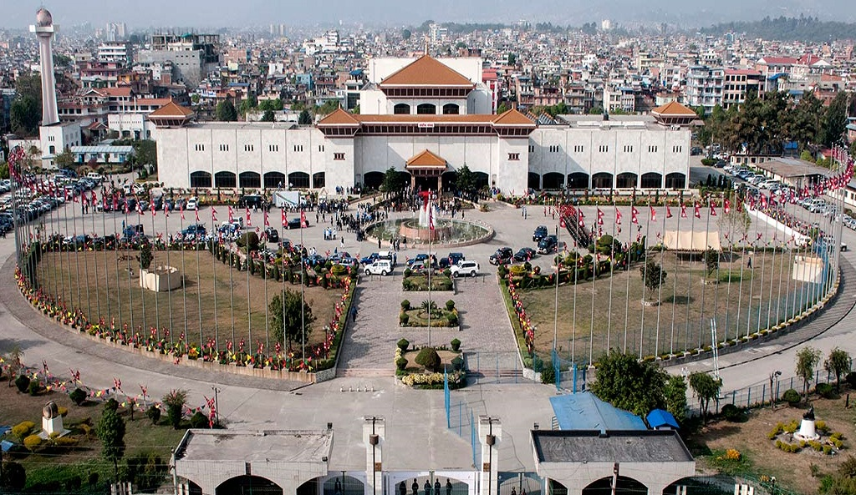
Classification of Local Government

Slide 2
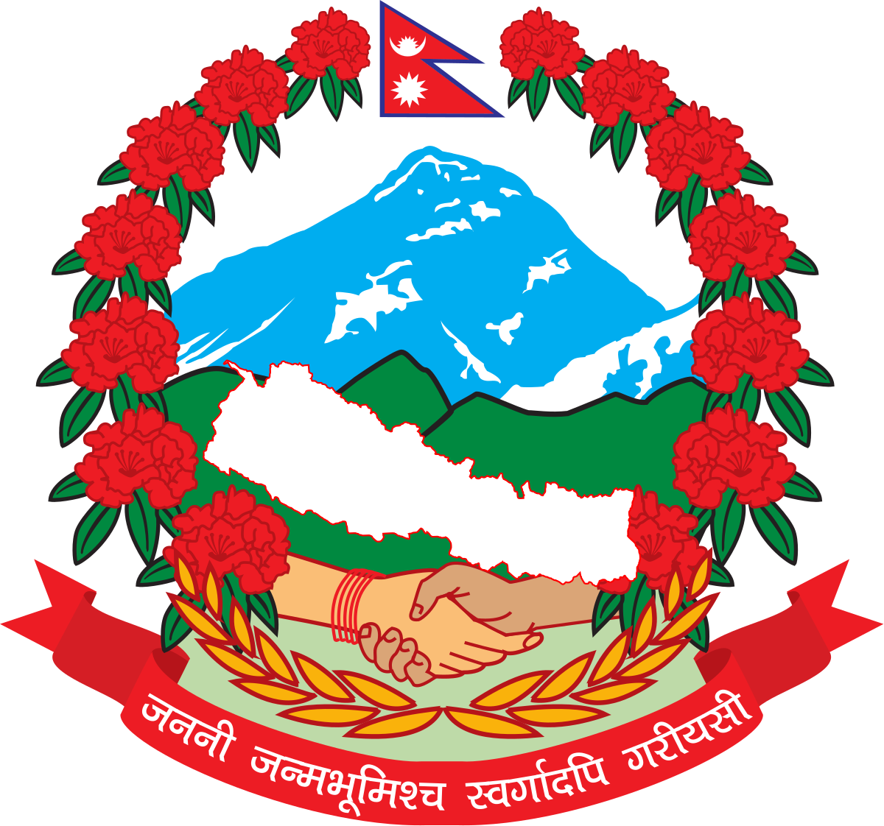
Government
The system or group of people governing an organized community, generally a state.
Effective operation of government – People may get peace & security.
It protects the nationality and sovereignty.
Three branches : Executive, legislative, and Judiciary.

Slide 3
3 Tiers of Government
Federation
Province
Local Level

Slide 4
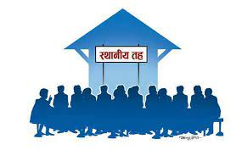
Local Government
Third level of government division constituted by local election.
It is established by law and ruled by local leaders. Mayor is the supreme of each local government.
Names of LG - Thumbs (Kirant Period) & Panchali (Lichchavi Period).
Door step government to the local people.
It solves local problems, empower local people, and ensure citizen’s participation into the governing system of local government.
Effective utilization of resources and service delivery.

Slide 5
“
Under the local level, there shall be Village Council, Municipal Council and District Assembly.
- Constitution of Nepal 2015
(Article 56)

Slide 6
Nepali local governments: pre 2015
(Keshav K. Acharya, 2018)
Traditionally – Highly centralized
In 1950 - A democratic system was established
In 1960 - Panchayat system was introduced
In 1992 - Newly - elected government introduced legislation that provided for the powers and responsibilities of local governments to be extended
In 1999 - The government enacted the Local Self- Governance Act ( 1999 )
In 2002 - Due to Maoist Communist Party insurgency, the government was not able to conduct the required local government elections
In 2006 – A comprehensive peace accord was signed between the government and the Communist Party ( Lawoti & Pahari, 2010 )

Slide 7
Nepali local government : since 2015
(Keshav K. Acharya, 2018)
1. Constitutional recognition
2. Local elections and citizen involvement
3. Technical and administrative capacity
4. Fiscal capacity
5. Formulation of regulations and guidelines

Slide 8
77
753
6743
Districts
Local level governments in Nepal
Wards

Slide 9
Numbers of
Local Governments
Metropolitan Cities | 6
Sub-Metropolitan Cities | 11
Municipal | 276
Village Council | 460

Slide 10
LOcal governments by type and provinces
Area type |  |  |  |  | Koshi | Madhesh | Bagmati | Gandaki | Lumbini | Karnali | Sudurpashchim | Nepal
 |  |  |  | Wards | 1,157 | 1,271 | 1,121 | 759 | 983 | 718 | 734 | 6,743
 |  |  | Metropolitan City |  | 1 | 1 | 3 | 1 | 0 | 0 | 0 | 6
 |  |  | Sub-metropolitan City |  | 2 | 3 | 1 | 0 | 4 | 0 | 1 | 11
 |  |  | Municipality |  | 46 | 73 | 41 | 26 | 32 | 25 | 33 | 276
 |  | Municipality total |  |  | 49 | 77 | 45 | 27 | 36 | 25 | 34 | 293
 |  | Rural Municipality |  |  | 88 | 59 | 74 | 58 | 73 | 54 | 54 | 460
 | Local level total |  |  |  | 137 | 136 | 119 | 85 | 109 | 79 | 88 | 753
District |  |  |  |  | 14 | 8 | 13 | 11 | 12 | 10 | 9 | 77

Slide 11
According to the Ministry of Federal Affairs and General Administration, 753 local units were classified into four grades on the basis of infrastructure and social development status:
Grade ‘A’ - Signifies most remote areas which includes 162 local units
Grade ‘B’ - Is a remote area with 218 local units
Grade ‘C’ - Refers to fairly accessible area with 275 local units
Grade ‘D’ - Is defined as easily accessible areas that has 98 local units

Slide 12
Determining Factors in the Classification of the Local Units
Availability of transport facilities
Distance from the province Capital
Distance from the district headquarters
Availability of education facilities at the local level
Access to telecommunications and electricity facilities
Status of health
Human development index
Geographical locations

Slide 13
Local People
Economic Need + Social Need
Local Problems
Problem Serving Needs
Local Government

Slide 14
How is Local Level Government Formed?
Municipalities
Urban Municipality Rural Municipality
-less than 10,000 populations
Metropolitan City Sub Metropolitan City Municipality
- More than 5 lakhs - More than 2 lakhs populations - more than 10,000 populations
populations
- Annual Income- 1,00,00,00,000+ - Annual Income- 25,000,000+
- Higher level - Basic communication service
Educational institutes
- Hospital, - Basic water supply and sanitation service
- Transportation facilities - Garbage treatment and management system
and many more

Slide 15
How is Local Level Government Formed?
Urban Municipalities, Rural Municipalities
Mayor/Chairman
Vice Mayor/Vice Chairman
Ward Members-4
Ward Chairman
Ward Members: 2 female- one must belong to dalit or minority group, 2 open

Slide 16
Candidates Requirements
Mayor, Deputy Mayor, Chairperson, Vice Chairperson, Ward Chairperson & ward members
Must be Nepali Citizen
Must be of 21 years of age
Must be a voter whose name is included in electoral rolls of the concerned municipality or Rural municipality
Not disqualified by any law
Tenure of Local Level Representatives
5 years

Slide 17
References
- Asia Pacific Journal of Public Administration, 2018 Vol. 40, No. 3, 186–197
- The Kathmandu Post, Rastriya Samachar Samiti; Published at: January 5, 2019
- Central Department of Public Administration, Tribubhan University
- Yogendra Raj Rijal ( 2011 ), Government Institutions & Local Governance, Bhrikuti Academic Publications
- Parashwor Dhungana, Chakra Prasad Dhungana, Esthaniya taha pachou taha dritiyae patra
- https://kathmandupost.com/national/2019/01/05/government-groups-local-federal-units-into-four- categories?fbclid=IwAR2uscHnDeK6cKNJYDQ16vNSqYS8Ls1lEQBiFDrvSqYpy1dIZweioJh-dqQ
https://en.wikipedia.org/wiki/Municipalities_of_Nepal#:~:text=There%20are%206%20metropolitan%20municipality,metropolitan%20municipality%20and%20276%20municipality.
- https://en.wikipedia.org/wiki/Elections_in_Nepal

Slide 18

Thanks!!!
Any questions?

